Slide 1



ETL Strategy
Ahnaf AKA “The Boss”
Zahra AKA “Queen Data”
Kai AKA “Court Jester”

Slide 2

Question: Where do people smoke the most..Tobacco
We used three separate data sets to determine in what states and what weather trends lead to a higher smoking prevalence

Slide 3

Data Selection & Extraction Strategy

Slide 4


Data Sources
As a group we had to determine and analyze a few sets of data to verify we would be able to join data strategically enough to answer our core question;
To get the Data we used :
Api call
Web Scraper
CSV

Slide 5
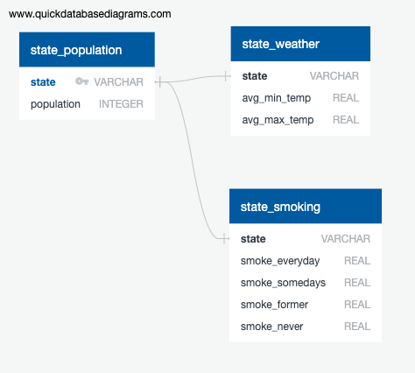
Database diagram

Slide 6

Bug hunting
As experienced data scientist we knew this task would require a fair amount of upfront effort to identify any and all impediments
We had to make a few pivots, clean out a few bugs
We initially tried to download a data set on US forest fires but could not get the file to cooperate- even with Zachs help.

Slide 7

Data Transformation and Cleaning Strategy

Slide 8



Tools of the trade
For most of the project we decided to utilize Jupyter notebook, VS and PGAdmin:
Some of the Dependencies were:
import pandas as pd
import numpy as np
from pandas import DataFrame
SQL Alchemy

Slide 9
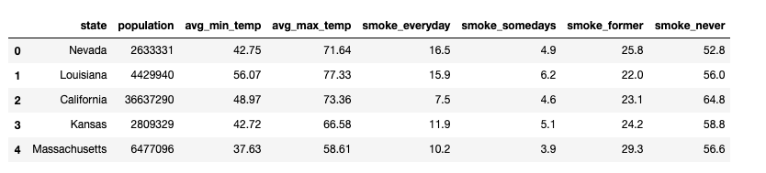
Final Dataset Join

Slide 10



Loading the Data and Data Warehouse Strategy

Slide 11

How it all went down..

